Slide 1
Public Health Brigades Information Session
May 17-29, 2022
Notes:
[ Throughout the notes section of this presentation is additional information pertaining to each slide. Each slide will only have brief bullet points (to prevent the viewer from being distracted by long paragraphs; the presenter should supplement each bullet point with the additional information provided here ]

Slide 2
About
Global Brigades
OUR MISSION
To empower volunteers and under-resourced communities to resolve global health and economic disparities and inspire all involved to collaboratively work towards an equal world.
GLOBAL BRIGADES IS AN INTERNATIONAL NON-PROFIT that empowers communities to meet their health and economic goals through university volunteers and local teams.
OUR VISION
To improve equality of life, by igniting the largest student-led social responsibility movement on the planet.
Notes:
Global Brigades is the world’s largest student-led global health and sustainable development organization. As a secular, international nonprofit organization, we mobilize student volunteers and professionals to empower communities in developing countries with programs that improve quality of life and environment, while respecting local culture. Students and professionals empower communities in Honduras, Panama, and Nicaragua.

Slide 3
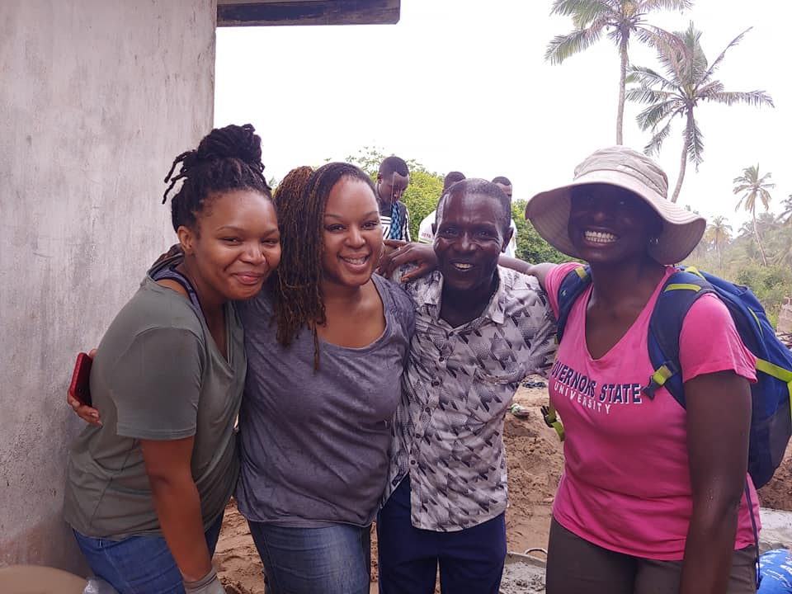
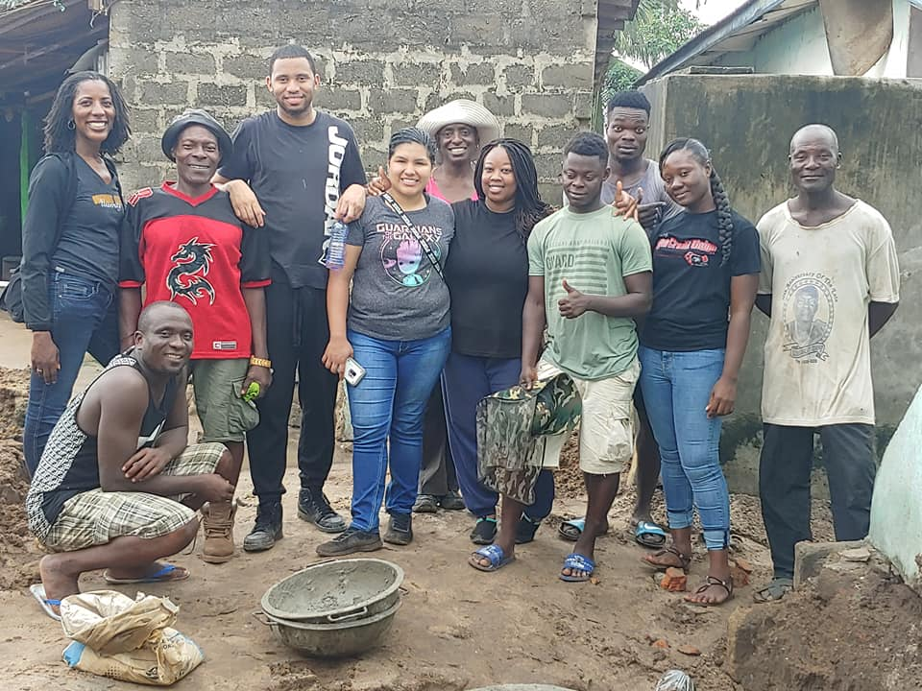
Public Health Brigade to Ghana
Click on the link above to view the video testimonials from 2019 participants!

Slide 4
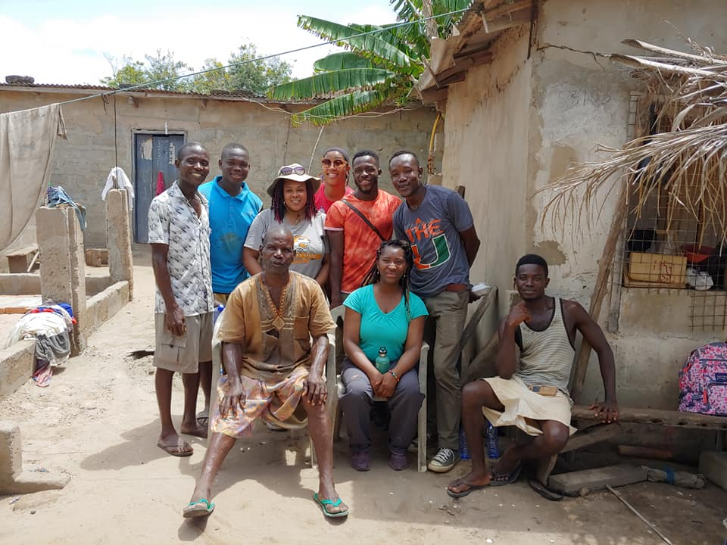
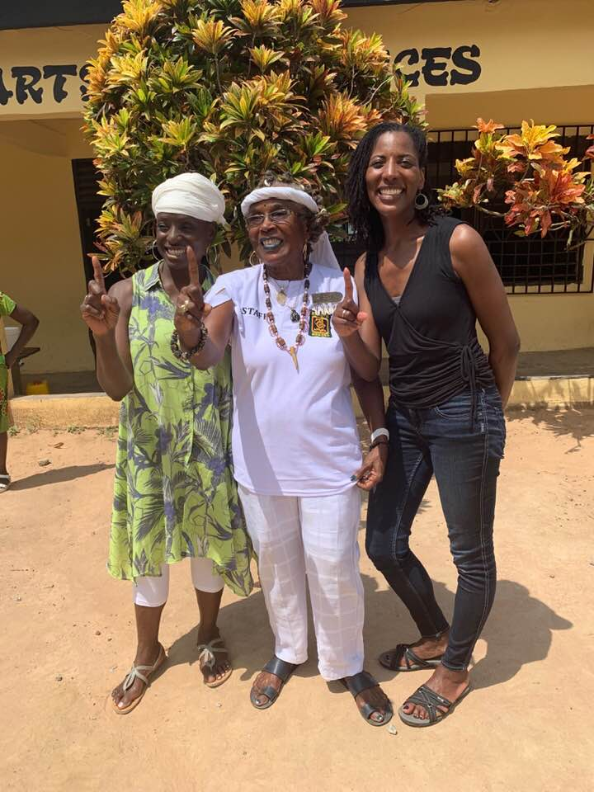
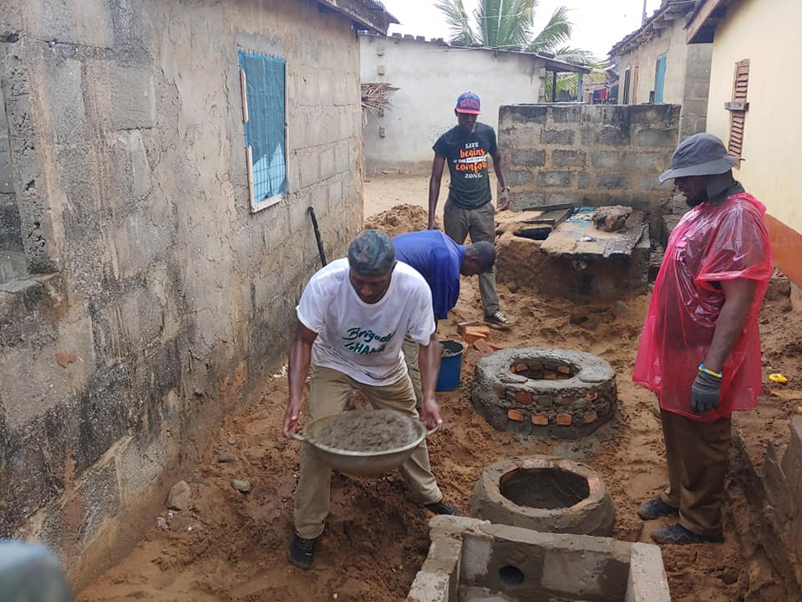
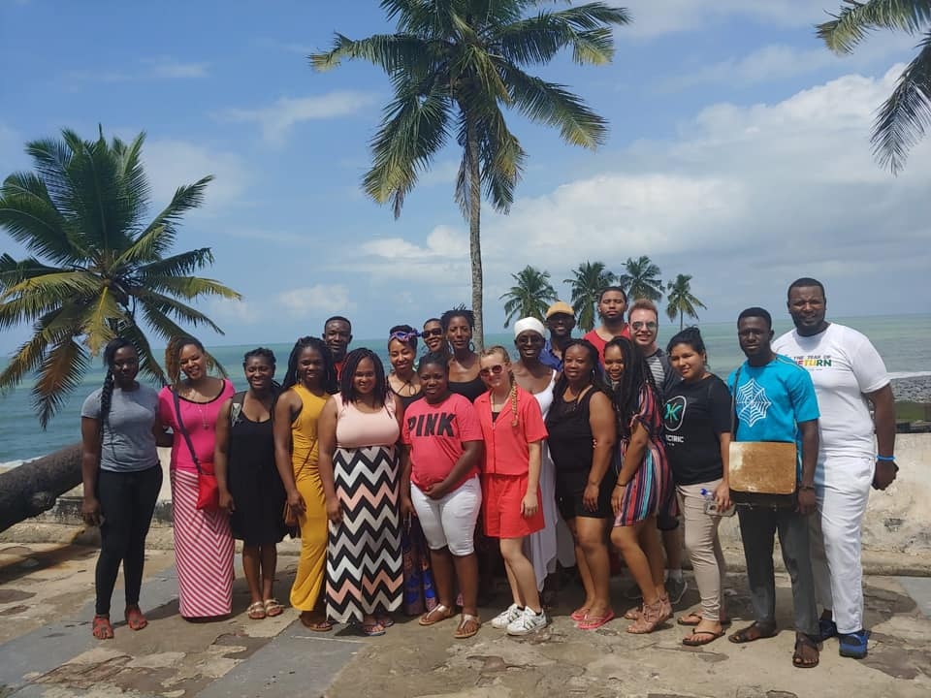
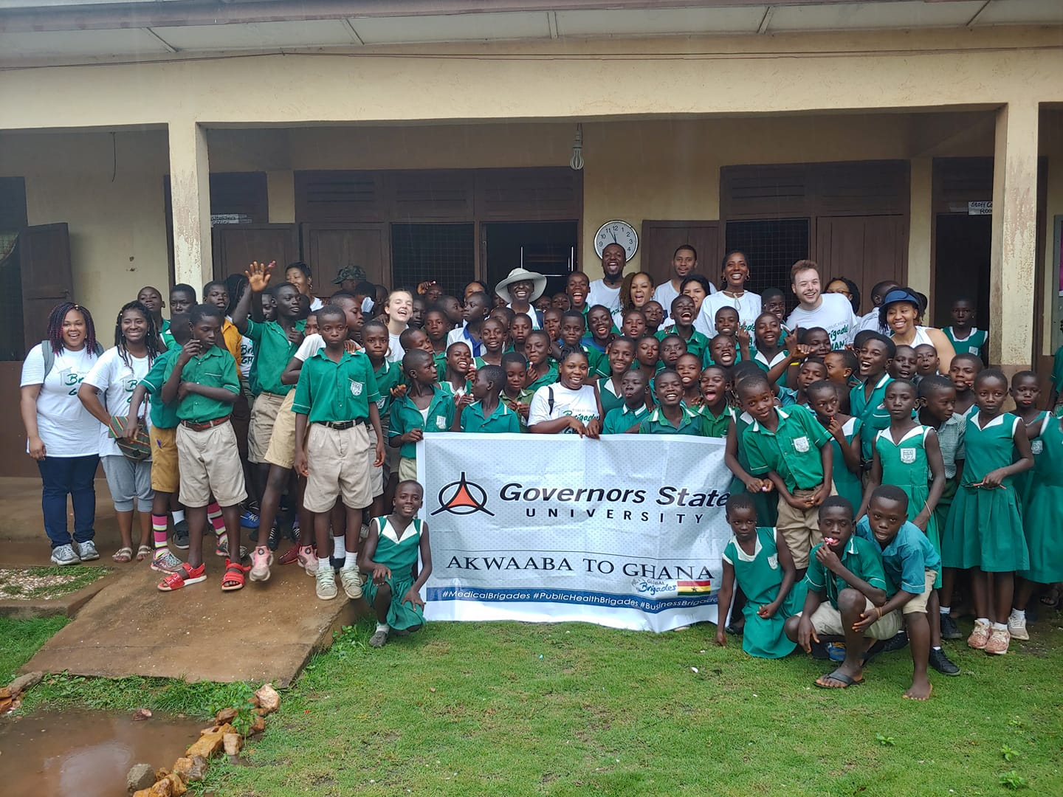
Ghana Photos 2019

Slide 5
About Global Brigades
7 SKILL BASED PROGRAMS OPERATING ACROSS 3 COUNTRIES
HONDURAS
Medical
Dental
Engineering
Water
Public Health
Business
Legal Empowerment
PANAMA
Medical
Dental
Public Health
Business
Legal Empowerment
GHANA
Medical
Water
Public Health
Business
NICARAGUA
Volunteer Brigades
in Nicaragua are currently unavailable, although our local team is still actively implementing the Holistic Model

Slide 6
Global Brigades delivers integrated health and economic programs to meet a community’s development goals.

Slide 7
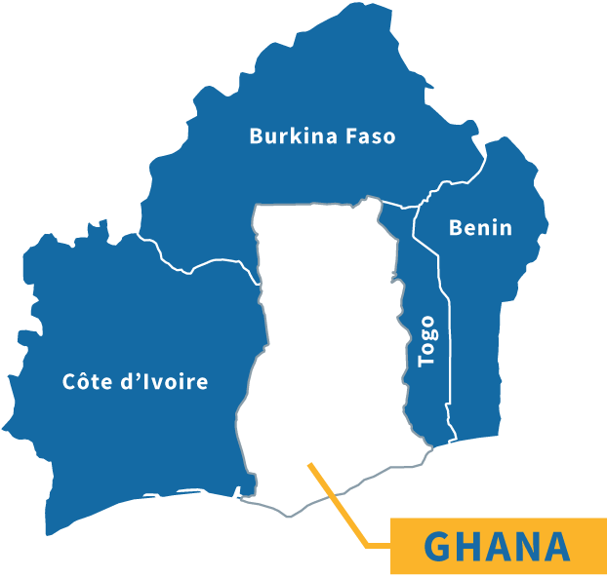
Ghana
RURAL GHANA
12.9 million people⁺ ^{Total Population: 28.8 million}
Over 4.3 million people lack access to clean water⁺
Over 11.7 million people lack access to improved sanitation infrastructure
37.9% of rural population lives below the poverty line⁺
1,641.49 USD GDP per capita⁺
Over 43% of children ages 12-17 are not enrolled in school
Notes:
⁺information from World Data Bank 2015

Slide 8
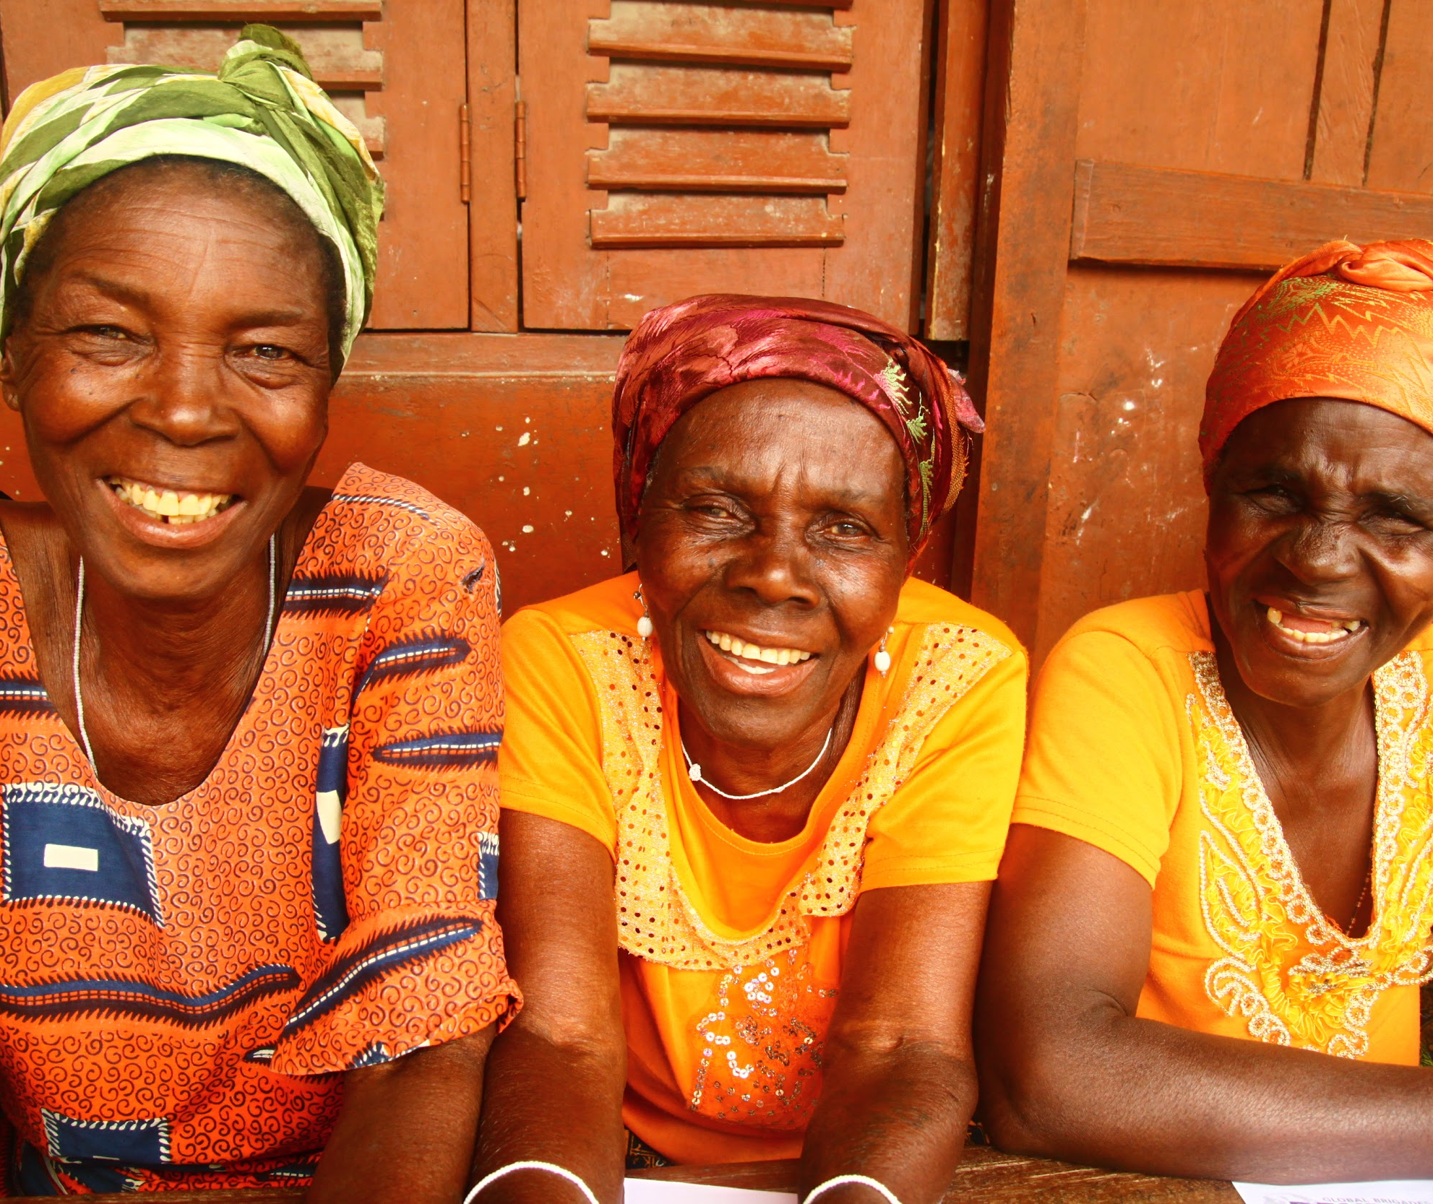
Why Public Health?

Slide 9
Why Public Health? The Challenges
91%
of people in rural Ghana lack access
to basic or safely managed sanitation facilities.
Notes:
Source: Health Indicator database. Regional Initiative of Health Indicator, Pan American Health Organization (PAHO), 2009. http://ais.paho.org/phip/viz/cip_coverageandsanitation.asp
“Improved” sanitation infrastructure considered connection to a public sewer, connection to a septic system, pour-flush latrine, access to a pit latrine, or access to a ventilated improved pit latrine

Slide 10
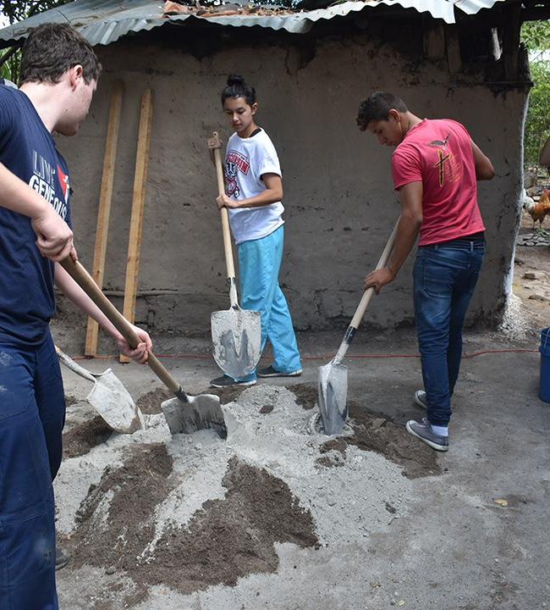
Why Public Health? The Challenges
HEALTH
Open defecation is an issue that must be addressed in rural Ghana
Inability to store clean water reduces overall water use for personal consumption
SANITATION AND HYGIENE
Lack of proper latrines expose families to risks of contamination
TIME AND QUALITY OF LIFE
Walking to water sources can be time consuming and heavy on the body
Improved sanitation and hygiene practices decrease frequency of commonly occurring diseases
Notes:
"The World Health Organization (WHO) estimates that exposure to smoke from the simple act of cooking constitutes the fourth leading risk factor for disease in developing countries, and causes 4.3 million premature deaths per year – exceeding deaths attributable to malaria or tuberculosis. In addition, tens of millions more fall sick with illnesses that could readily be prevented with improved adoption of clean and efficient cookstoves and fuels.' - Global Alliance for Clean Cookstoves
"Typical wood-fired cookstoves and open fires emit small particles, carbon monoxide, and other noxious fumes that are up to 100 times higher than the recommended limits set by WHO, and in some settings, considerably higher."- Global Alliance for Clean Cookstoves
"Around 3 billion people cook and heat their homes using open fires and simple stoves burning biomass (wood, animal dung and crop waste) and coal.
Over 4 million people die prematurely from illness attributable to the household air pollution from cooking with solid fuels.
More than 50% of premature deaths due to pneumonia among children under 5 are caused by the particulate matter (soot) inhaled from household air pollution.
3.8 million premature deaths annually from noncommunicable diseases including stroke, ischaemic heart disease, chronic obstructive pulmonary disease (COPD) and lung cancer are attributed to exposure to household air pollution."- WHO

Slide 11
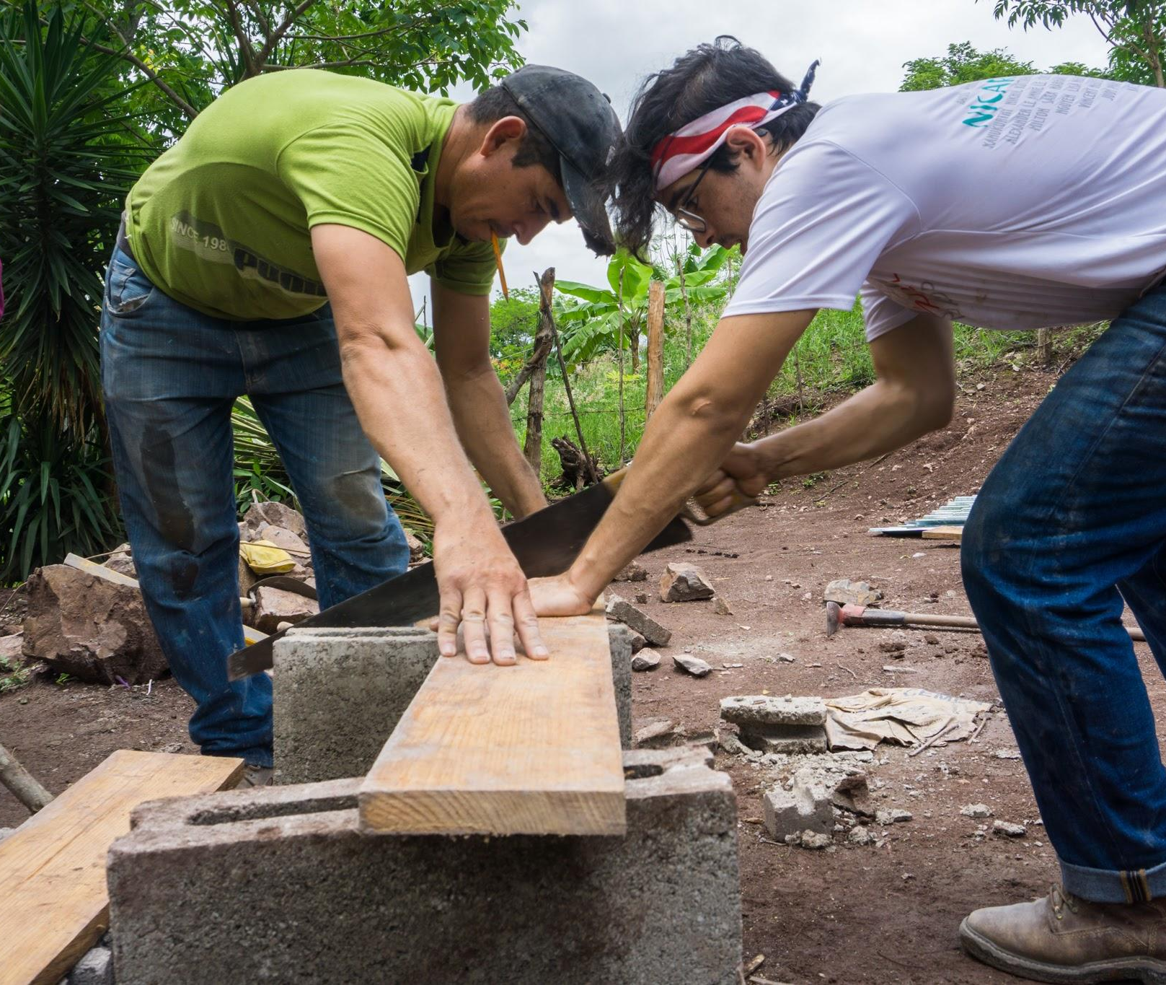
Public Health
Program
Public Health's mission is to empower rural Ghanaian communities to prevent common illnesses through in-home infrastructural development, community leader training, and health education.

Slide 12
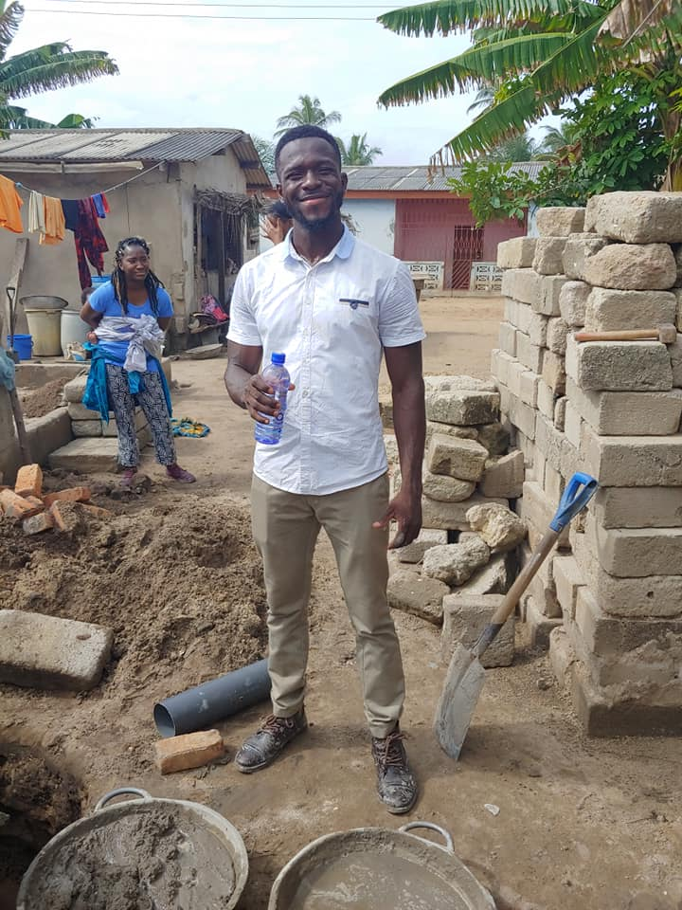
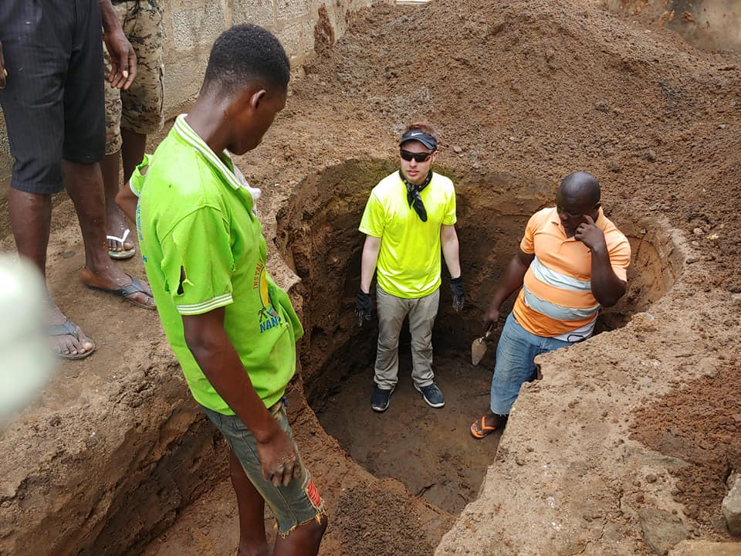
Meet the Team
PUBLIC HEALTH PROGRAM TEAM
Builds community relations
Works with communities in preparation for brigade arrival
Capacity-building and education
Performs community follow-up and evaluations
Leads your brigade

Slide 13
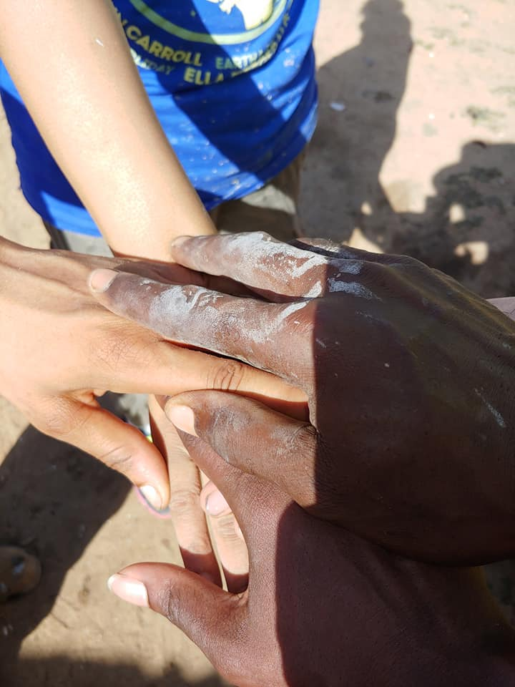
The Public Health Program
THE PUBLIC HEALTH PROGRAM IN GHANA CONSISTS OF:
Infrastructure Development
Advocate for Public Health projects and help instruct proper usage and maintenance of infrastructure
Healthy Households Initiative
Monitor and evaluate household health environments
Community Health Workers (CHWs)
Community volunteers who provide patient care in order to promote preventative health care and overall community health
Maintenance and Follow-Up
Full time staff working year-round as resources and mentors in communities
Public Health Brigades
Volunteers construct household health infrastructure projects and collaborate with the and CHWs on project follow-up and community education, securing access to resources and information necessary to promote good sanitation and hygiene practices

Slide 14
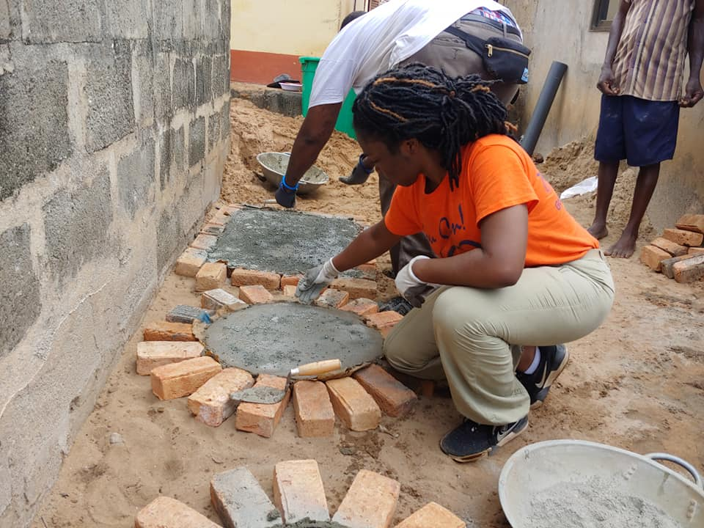
Public Health Projects
LATRINES
Build latrines for sanitary and proper waste disposal
A convenient and inexpensive solution near the home
Biodigester septic tank included in design

Slide 15
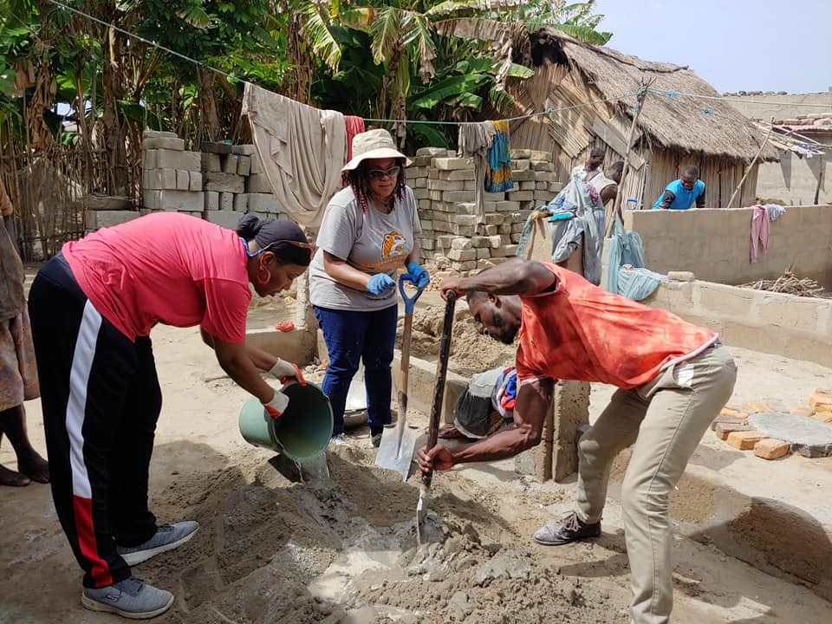
Public Health
Brigades
Notes:
The community benefits greatly from direct volunteer involvement. It is a huge motivational factor to see volunteers committed to a community’s access to needed public health infrastructure. In addition they benefit from the education workshops given by student volunteers. Each volunteer also indirectly supports, through their program contributions, sustainability aspects like training a water council, and allowing staff to check up with communities and confirm that the systems are being operated properly.
The volunteer also gains many benefits from direct volunteering. They are providing a community with not just public health infrastructure, but health and economic potential. The volunteer also gets to directly apply their education, weather it is public health, engineering, Spanish, international development or more. A volunteer also gets to experience a developing country and gains a better perspective on how the majority of the world lives.

Slide 16
Public Health Brigades
FOR EVERY FOUR
PUBLIC HEALTH
VOLUNTEERS
1 FAMILY
CAN BENEFIT FROM
A LATRINE
=

Slide 17
Public Health Brigades
Volunteers empower rural communities to prevent common illnesses through in-home infrastructural development, community leader training, and health education.

Slide 18
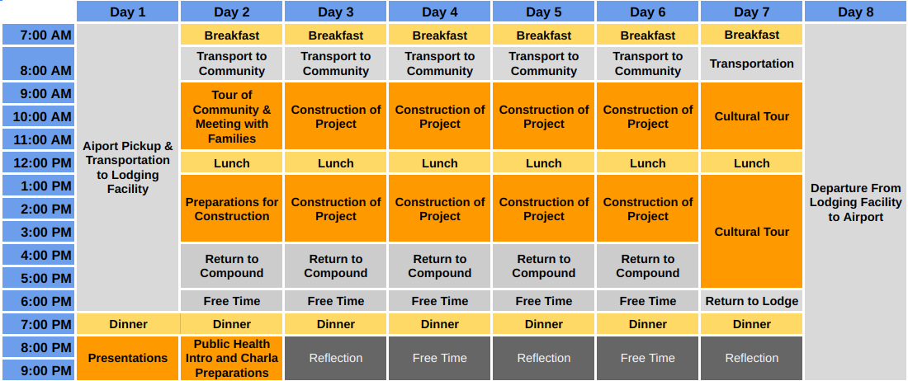
Sample Itinerary
(8 Days)
Note: This is a typical Global Brigade Public Health Brigade itinerary.
We have added extra days to this itinerary for students to experience other parts of Ghana.

Slide 19
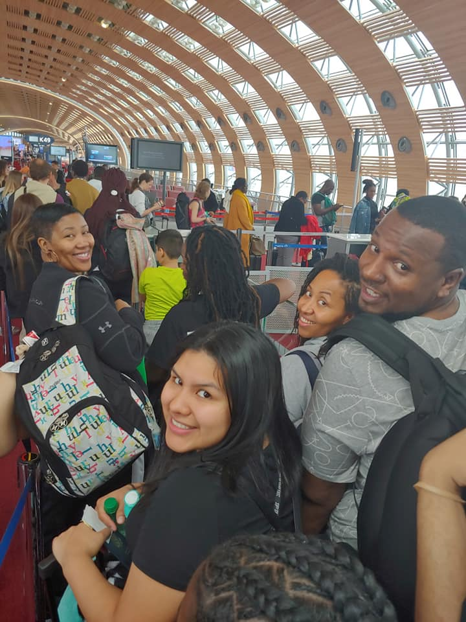
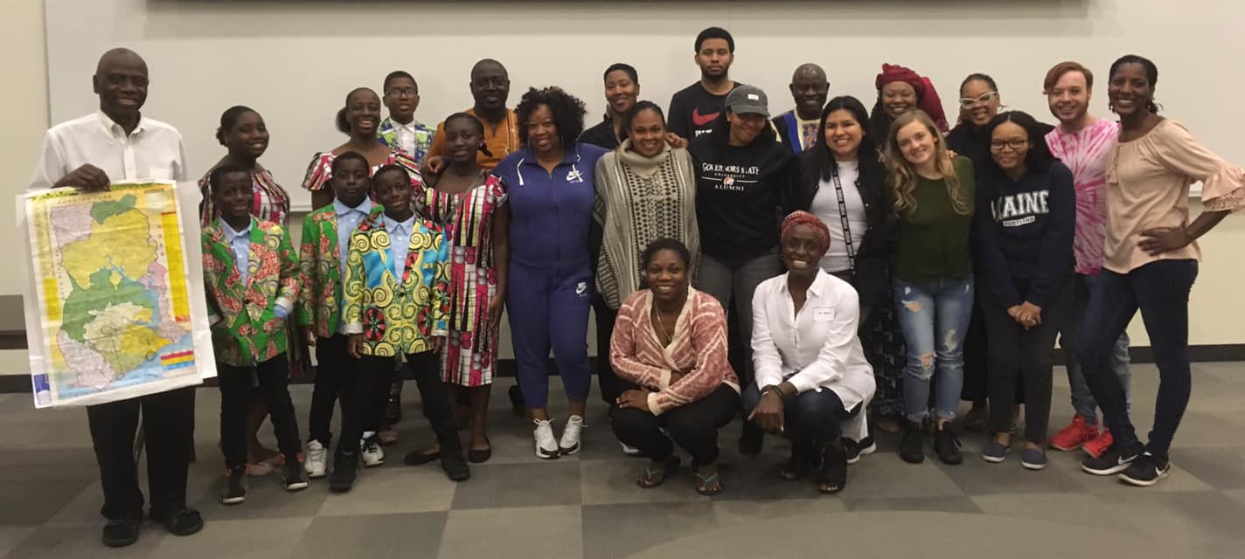
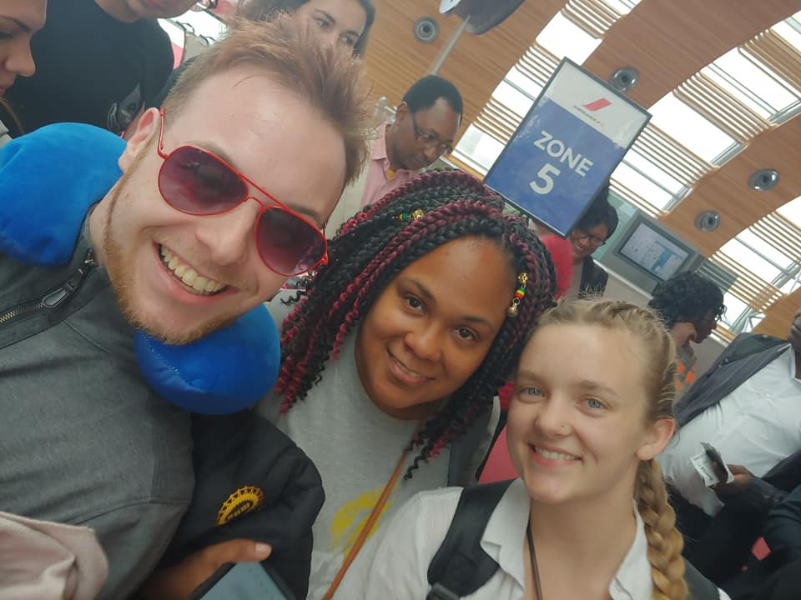
Itinerary
PRE-DEPARTURE
Teambuilding, education, cultural preparation, fundraising
Health, safety & travel preparation
Engagement with Ghanaian community members in the Chicago area
DEPARTURE
Meet at the airport and take group flight together to Ghana & Public Health

Slide 20
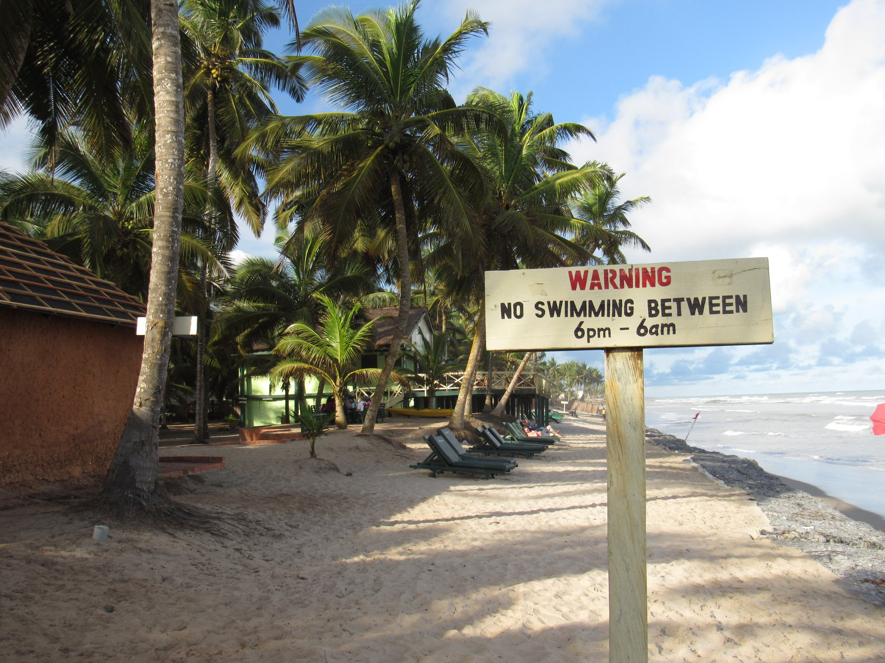
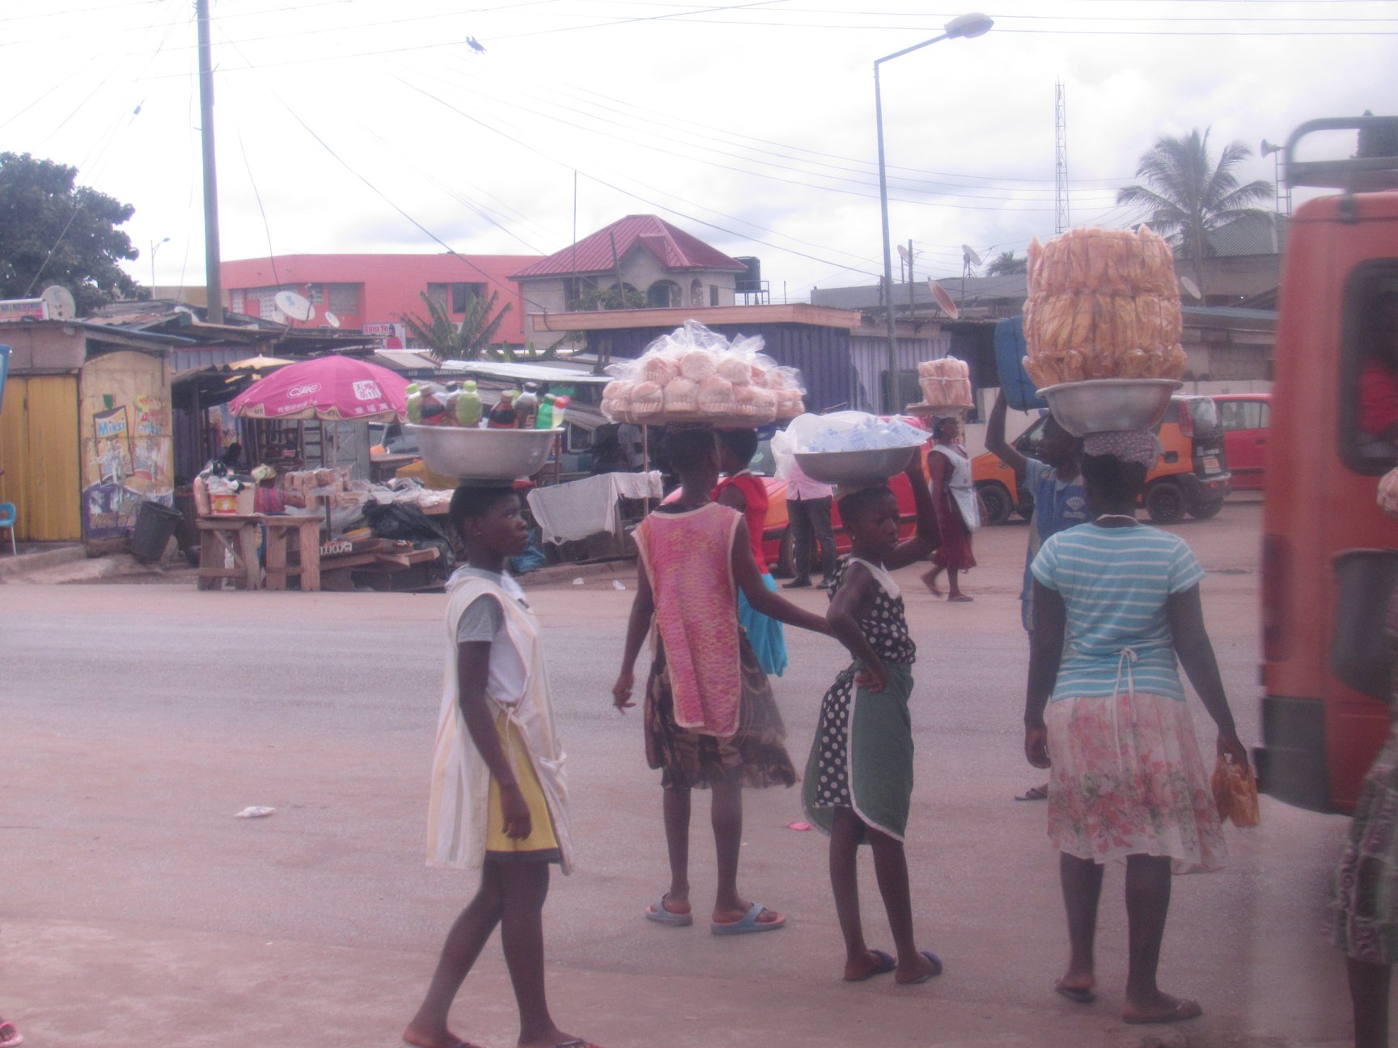
Itinerary
DAY 1: ARRIVAL IN ACCRA
DAY 2: PUBLIC HEALTH INTRODUCTION
Meet the Public Health Brigades team
Transportation to lodging facility
Electricity, showers, bathrooms, beds, linens, pillows, 24 hour security, clean drinking water, daily meals provided
Introduction to Ghana & Public Health
Challenges
Community Needs
Impact of Public Health projects
DAY 3: COMMUNITY VISIT AND HEALTHY HOUSEHOLD ASSESSMENT
Community visit
Meeting with community leaders
Go on household visits
Monitor and evaluate household health environment
Offer recommendations to improve public health projects
Record household data on tracking sheets and compile into post-brigade reports

Slide 21
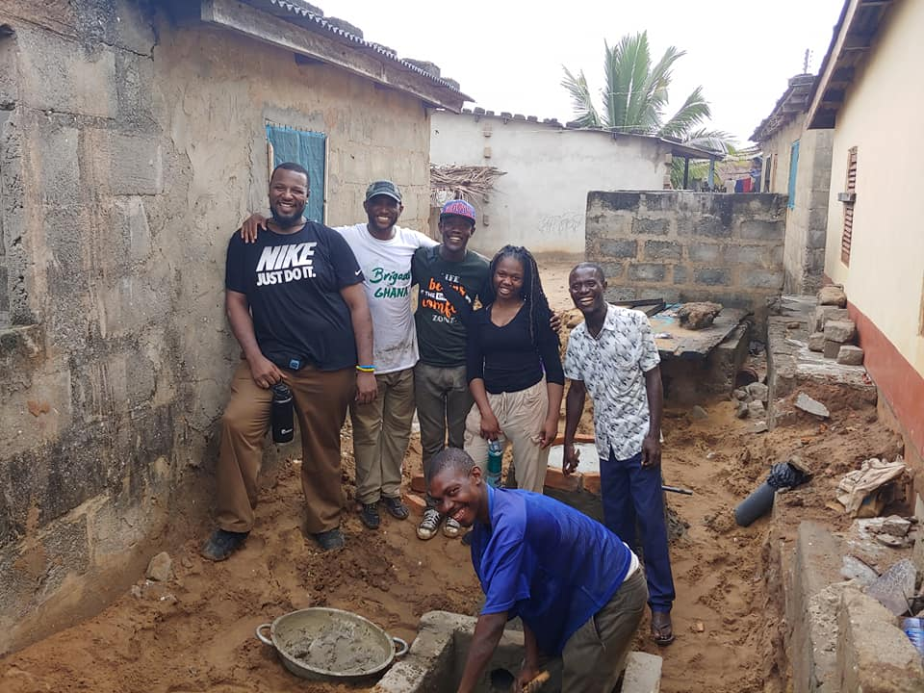
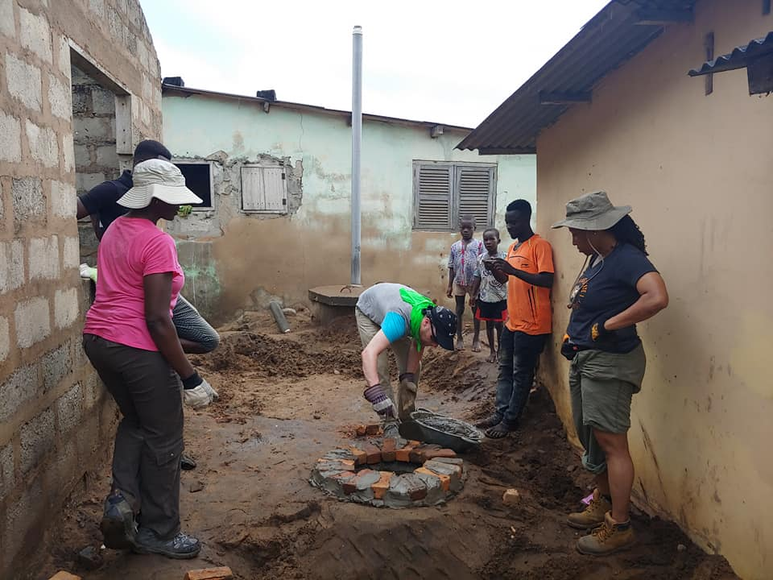
Itinerary
DAYS 4-6: PROJECT IMPLEMENTATION
Construct Public Health projects in households
Divide into small groups to work in households alongside local masons and family members
Bond with and learn from family members
Projects consist of:
Eco-stoves
Latrines
DAY 7: EDUCATION WORKSHOP AND PUBLIC HEALTH FAMILY GOODBYES
Lead interactive educational workshop (skits, posters, etc.)
Common education topics:
The importance of public health projects, Personal hygiene, Waste management
Education ensures projects are sustainable in the future
Say goodbye to families from project implementation days

Slide 22
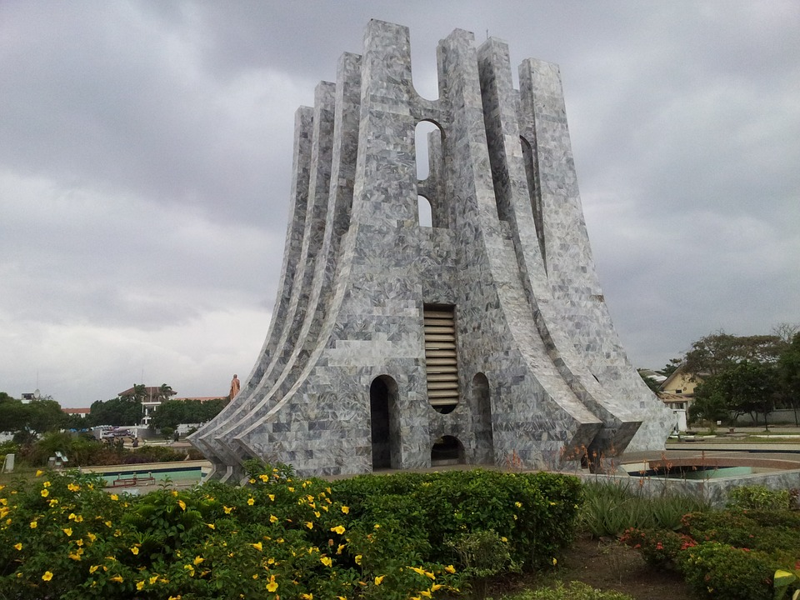
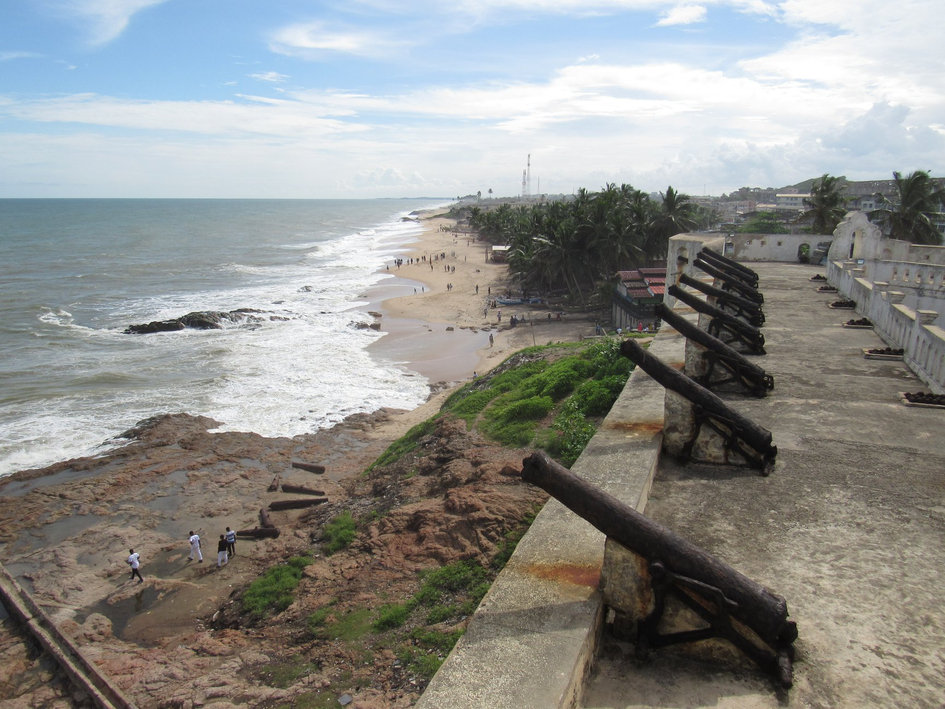
Itinerary
DAY 8: CULTURAL DAY
Cultural Tour (Last Bath)
Lunch
Cape Coast Castle Tour

Slide 23
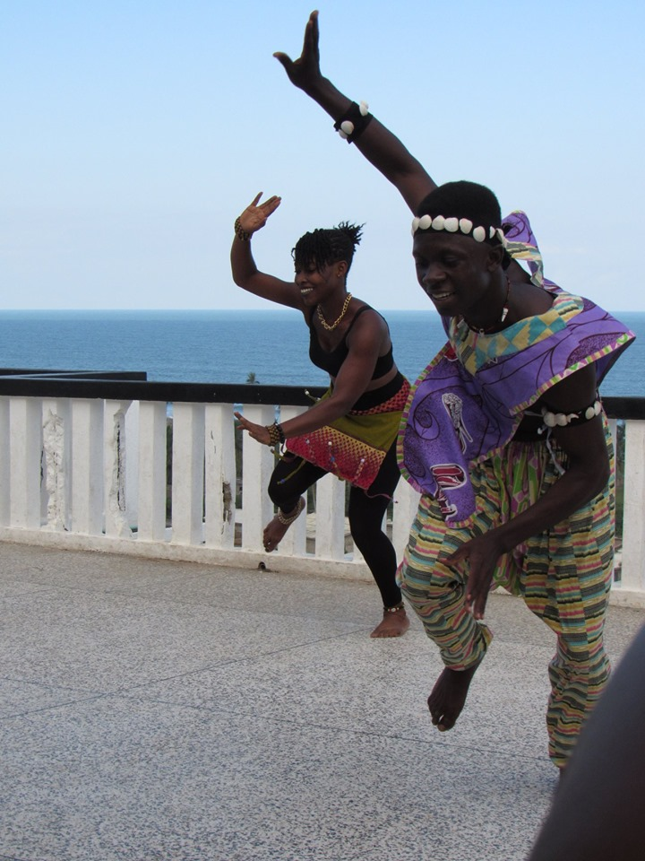
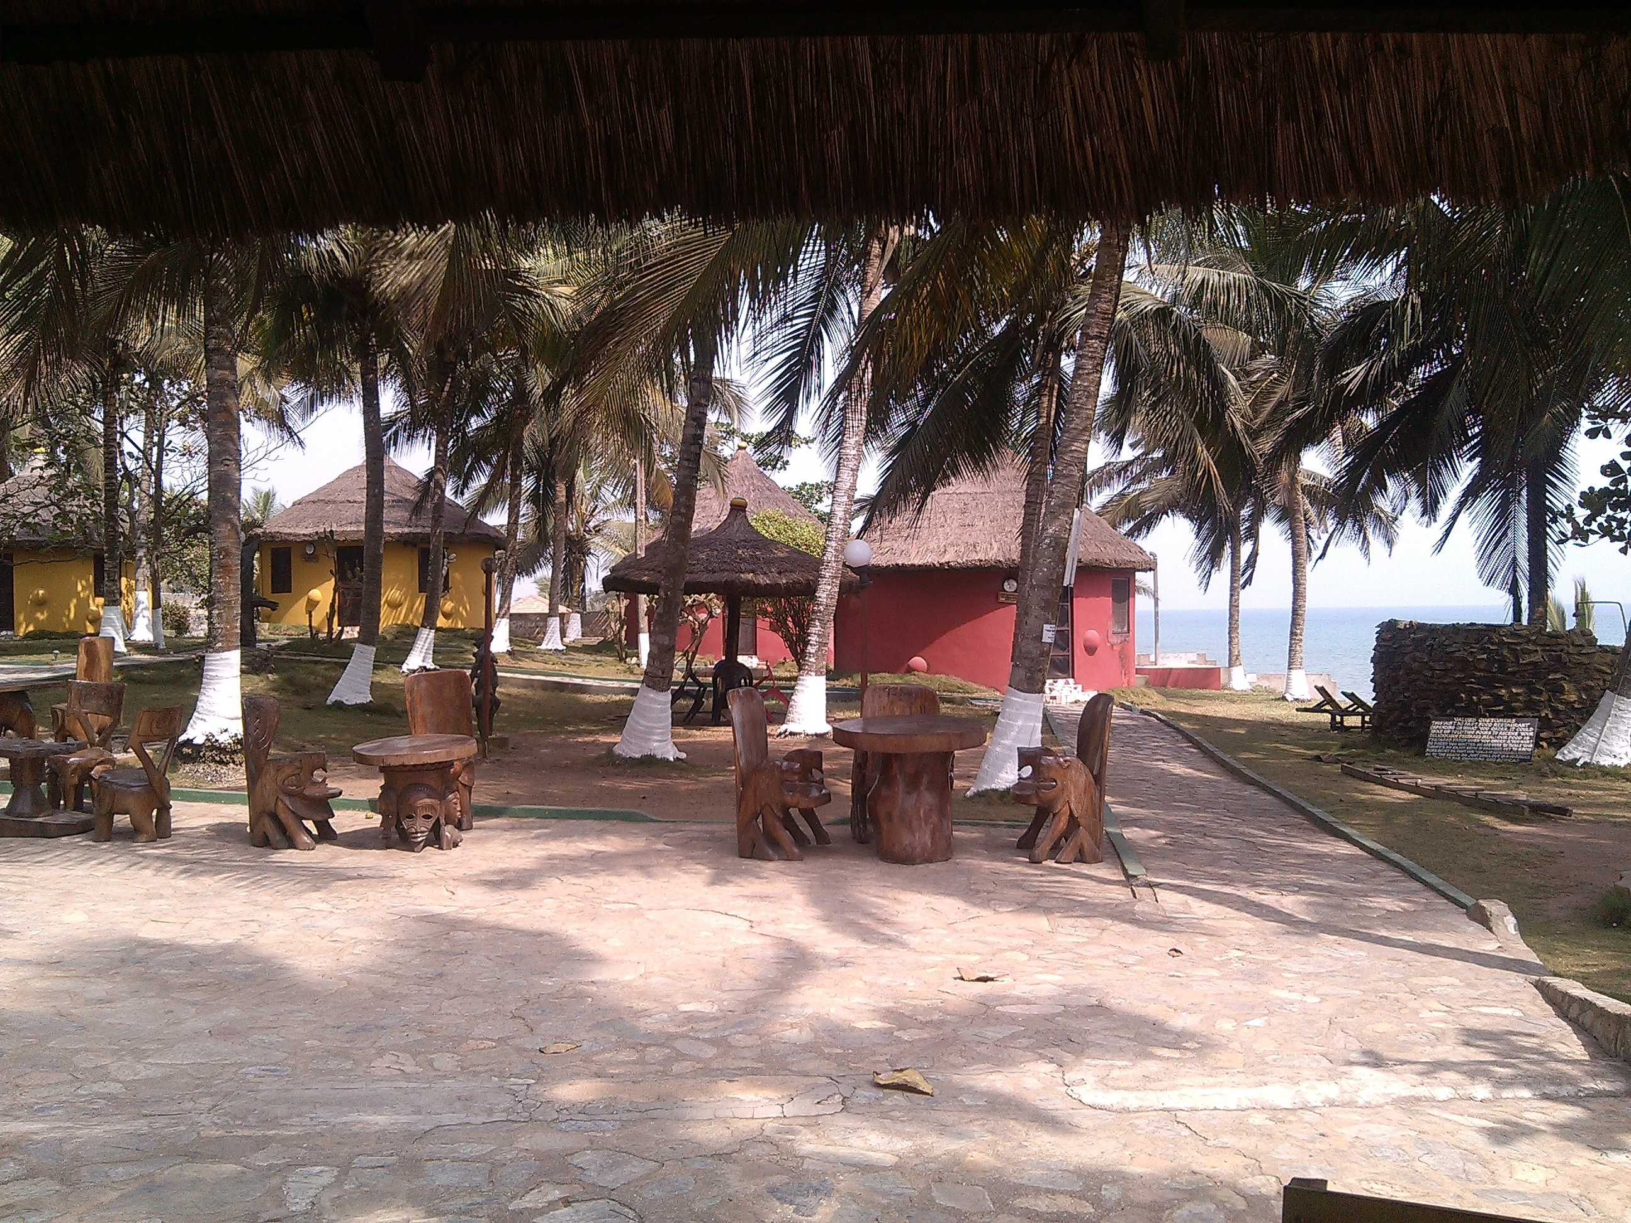
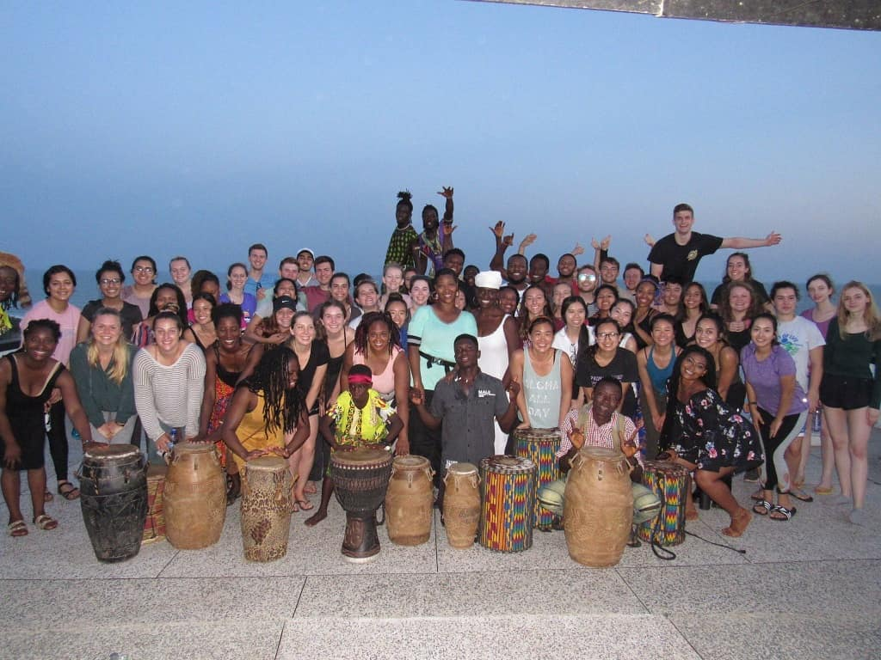
Itinerary
DAY 9 & 10: ONE AFRICA
Cultural Tour
Lunch at One Africa
Cultural immersions (Cultural Dance)
Final Reflections with GB Ghana Staff

Slide 24
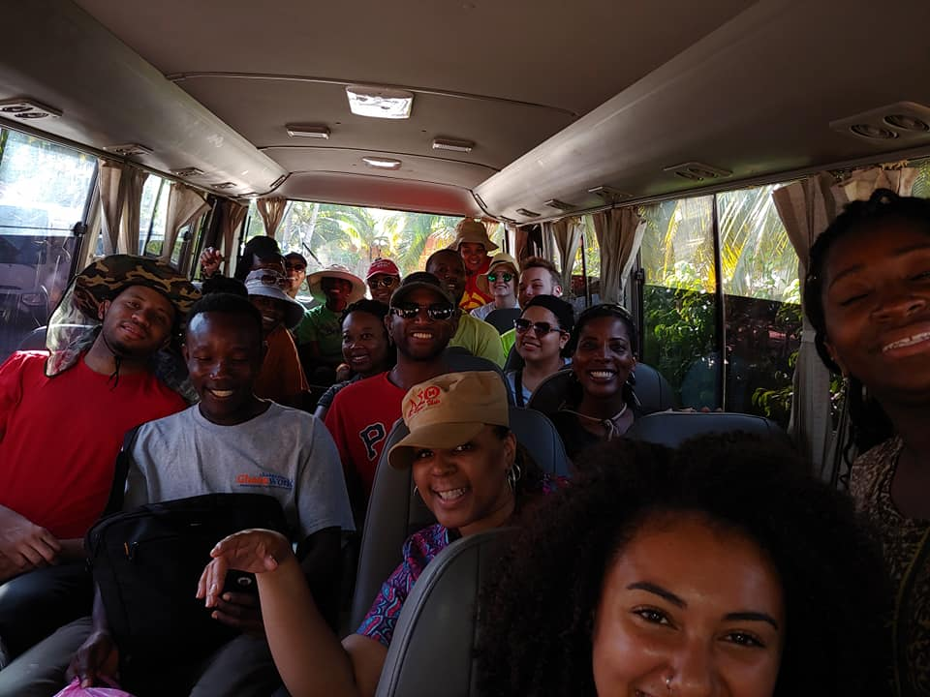
Itinerary
DAY 11: DEPARTURE
Transportation to airport
Start planning for your next brigade!
Set goals
Leadership positions
Share your story!
Get connected through Global Brigades’ networks
Get updates on the community you worked with
Learn & share about public health challenges in your community & around the world

Slide 25
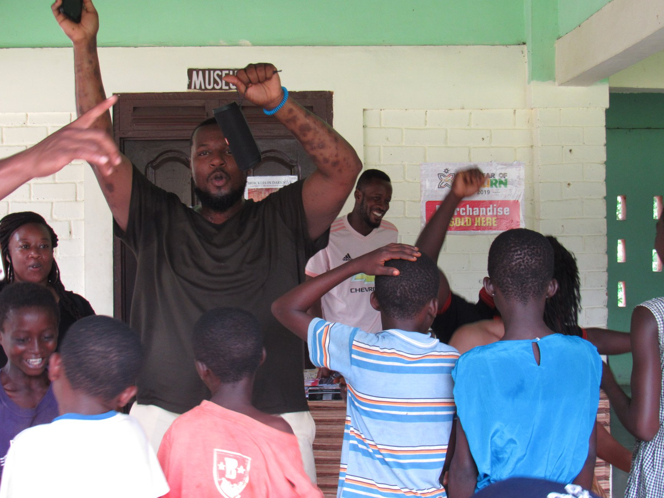
Public Health Brigades
EDUCATION WORKSHOPS
Adult and Family Health Education
Focuses on the importance, care, and maintenance of the construction projects
This also initiates the proper dialogue to share other critical health concepts, such as treatment of potable drinking water and proper sanitation practices
Kids’ Health Education
Dynamic mix of songs, games, and interactive simple activities but highly effective
Teaches health promotion and disease prevention methods, and serves as a supplement to health education already taking place in the classroom

Slide 26
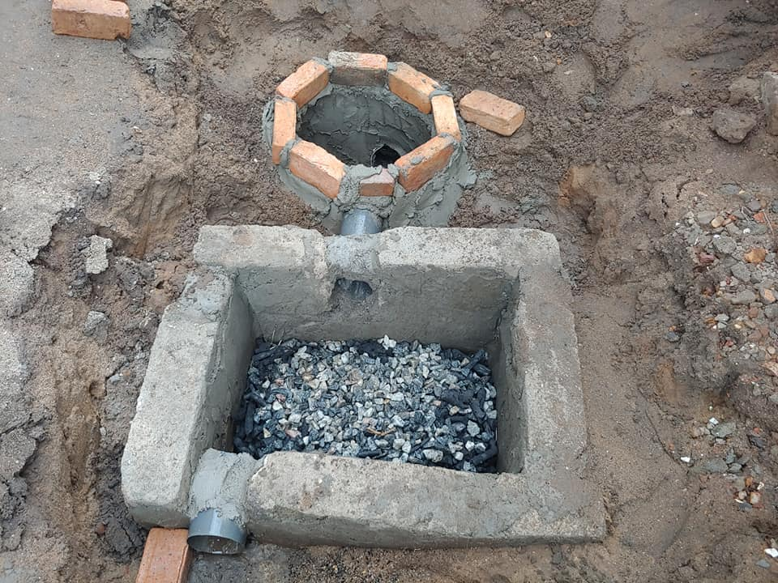
The
Result

Slide 27
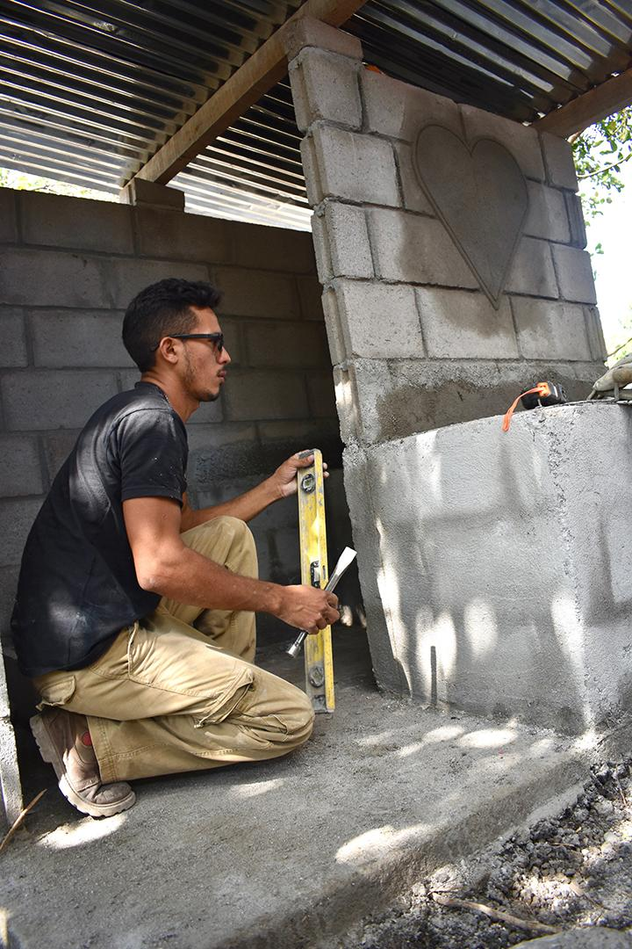
The Result
HEALTH
CHWs serve as a sustainable health care presence in communities
Medical Brigades will see decreased numbers of patients experiencing illnesses related to the healthy household projects such as skin diseases and respiratory illnesses
SANITATION AND HYGIENE
Households have access to a proper waste disposal system

Slide 28
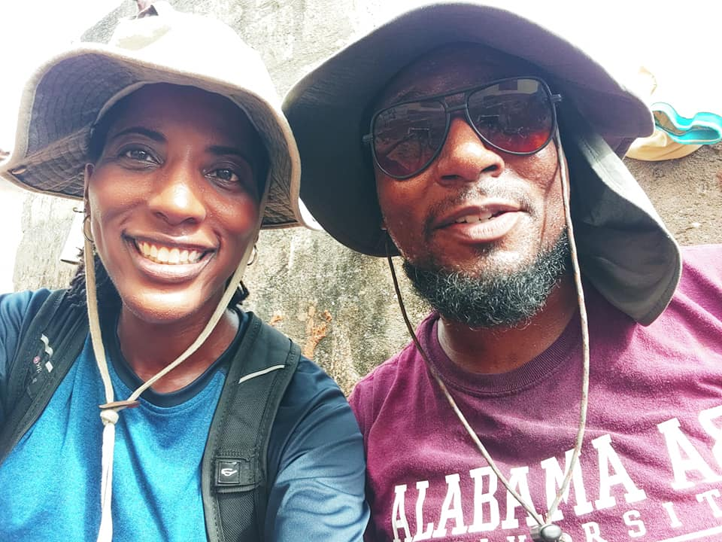
Get
Involved

Slide 29
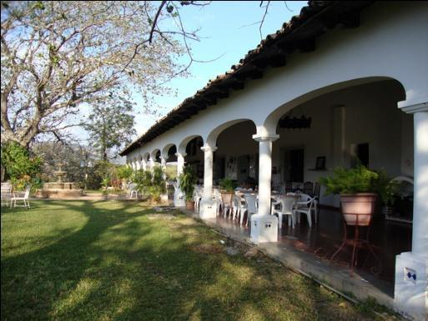
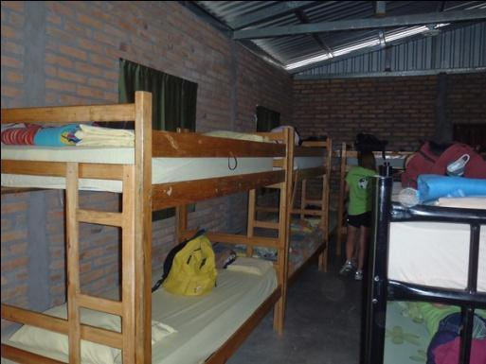
PUBLIC HEALTH BRIGADES INFO SESSION – TOTAL CONTRIBUTION
Program Fee: 3,450*
PROGRAM CONTRIBUTION DETAILS
Accommodations & meals (vegetarian options available)
Clean drinking water
Airport pick-up and drop-off
In-country transportation
Translators and coordinators, and security
Program sustainability and follow-up between brigades
Site Visits and tours
Public Health Project Materials
International flight
International health insurance
Ghana Visa
COVID Testing
Flight Insurance
*This is an estimate, we are currently confirming flight cost.
Notes:
Volunteers will be lodged in a group compound. All accommodations are clean and safe. There is electricity, bathrooms and clean drinking water on site. Meals are prepared on site using clean water and food specifically for the brigade. A GB staff member will be with the volunteers at all times and available for 24 hour assistance.
For the complete breakdown visit - http://globalbrigades.wikidot.com/student-materials:program-donations:program-contribution. Remember to express that the program contribution contains $100 towards the public health projects.
[ Actual lodging facility will most likely not be determined until a week or two before a brigade, due to logistics of arranging volunteers and frequent changing volunteer numbers up to the actual brigade. ]

Slide 30
PUBLIC HEALTH BRIGADES INFO SESSION
OUT OF POCKET EXPENSES
Vaccinations (COVID-19, Yellow Fever, Typhoid, Hep A, Hep B, Malaria)
Pre-Departure COVID testing
Tuition & fees/ auditing fee of $75
Please note, due to the uncertainty of the ongoing pandemic, your program may be subject to additional expenses to meet new required government policies and procedures. GSU will make best efforts to communicate new rules and policies as soon as we learn in order to share the impact on your program.
Notes:
Volunteers will be lodged in a group compound. All accommodations are clean and safe. There is electricity, bathrooms and clean drinking water on site. Meals are prepared on site using clean water and food specifically for the brigade. A GB staff member will be with the volunteers at all times and available for 24 hour assistance.
For the complete breakdown visit - http://globalbrigades.wikidot.com/student-materials:program-donations:program-contribution. Remember to express that the program contribution contains $100 towards the public health projects.
[ Actual lodging facility will most likely not be determined until a week or two before a brigade, due to logistics of arranging volunteers and frequent changing volunteer numbers up to the actual brigade. ]

Slide 31
Health & Safety
Department of State: LEVEL 2 – Exercise increased caution. CDC: LEVEL 2 - Moderate - Make sure you are fully vaccinated before traveling to the Ghana.
GSU will be closely monitoring the travel advisories and other health and safety risks as we get closer to the travel period.

Slide 32
COVID-19 PRECAUTIONS
All participants must be fully vaccinated
COVID testing is required prior to travel, upon arrival in country and upon departure (cost of in-country testing is covered by program fee)
COVID insurance
Reduced capacity with accommodations and vehicles
All volunteers must wear masks at all times
Global Brigades hired a new COVID-19 coordinator
Daily Temperature testing
Any symptoms are reported to the doctor on the compound
The requirements for travel are changing everyday.
Resources: Please find the list of resources that could be helpful to understand the situation in Ghana:
Ghana Health Services
Reuters
WHO
COVID-19 Safety Protocols
Responding to Covid-19 (Global Brigades)

Slide 33
Insurance
International Health Insurance All participants will be enrolled in international health insurance. Ask OIS for more details on the plan.
Treatment for COVID-19 would be considered like any other medical condition and is subject to the policy terms and conditions. If you experience symptoms, you should seek medical care. Expenses resulting from Medically Necessary treatment will be considered for reimbursement according to the policy terms, conditions and exclusions.
Cancel for Any Reason Insurance (CFAR) Participants will be encouraged to purchase Cancel for Any Reason insurance. Ask OIS for more details on the plan.

Slide 34
Protecting your investment
All payments made towards the brigade are refundable until February 1st
By February 1st , GSU will make a decision to cancel or move forward with the program
At that time, students will have the option to receive a full refund or purchase Cancel for Any Reason or Interrupt for Any Reason insurance

Slide 35
PUBLIC HEALTH BRIGADES INFO SESSION – CONTACT INFORMATION
FUNDING
Study Abroad Scholarship
- Awards between $250-750
- Applications due November 15th
- Complete scholarship form
- 2 Academic/Professional Letters of Recommendation
- 500-1000 Word Study Abroad Essay with follow-up project
- Resume
Student Leader Grants (3 grants of $250 each)
Dr. Phyllis West Global Service Learning Scholarship (one full scholarship for chosen First-Generation student who has never left the U.S.)
Financial Aid Refunds (if applicable)
Student Life Travel Grant (if applicable)
FUNDRAISING
Traditional Ways: Bake Sales, Ice Cream Sale, etc.
Reach out to Friends and Family for Donations
Matching Donation Companies
Local Businesses

Slide 36
Apply for your passport book @ your local post office
Passport application
Passport photos
Proof of U.S. Citizenship (birth certificate)
ID (driver’s license, state ID)
Personal Check/Money Order
$35 Administrative Fee
$110 Passport Book - 11 weeks
$60 Expedite - 7 weeks
$17.56 – 1-2 Day shipping
Passport Day at GSU Monday, November 8th 10:00 a.m. – 2:00 p.m.
Students planning to travel to Ghana should apply for their passport by December 15th for regular processing or by January 15th for expedited service.
For full application instructions, please visit the Government Website.

Slide 37
PUBLIC HEALTH BRIGADES INFO SESSION – JOIN THE NEXT BRIGADE
Apply for passport
Fill out application form and apply for grants/scholarships by Nov. 21st
Conduct Interview for acceptance
Pay first deposit by Dec. 1st (or upon acceptance)
Apply for Study Abroad Scholarship by Dec. 1st
Attend welcome meeting (TBD Dec. 13-17)
Pay second payment by Jan. 15th
Pay non-refundable payment by Feb. 1st
Confirm program and flights in February
Purchase Cancel For Any Reason Insurance
Pre-Brigade Curriculum
Submit visa documents (March)
Research vaccine info
Apply for external Scholarships (March)
Pay fourth payment by March 15th
Fundraise
Get Vaccinations & Submit proof to OIS
Pay Final Deposit by May 1st
Pre-Departure Orientation (May)
APPLICATION DEADLINES:
Due November 21st
Study Abroad Application
Leadership Grant Applications
Dr. Phyllis West Global Service Learning Scholar Application
Due December 1st
Study Abroad Scholarship Application
PAYMENT DEADLINES:
First Deposit Due ($250) – Dec. 1st
Second Payment Due ($600) – Jan. 15th
Third Payment Due ($600) – Feb. 1st
Fourth Payment Due ($600) – March 15th
Final Payment Due (Remaining balance) – May 1st
Notes:
[ Consider adding more information to this slide, such as due dates for the brigade application, deposit due dates, next meeting date/time/location. ]

Slide 38
Join the
Movement
QUESTIONS?
Contact Info: Amy Soub asoub1@govst.edu (Coordinator)
Dr. Nicole Koonce nkoonce@govst.edu (Faculty Leader)
Dr. Roseina Britton rbritton@govst.edu (Faculty Leader)

